Slide 1


Market Research:
Market findings and analysis

Slide 2


Written Statement Of Marketing objectives, strategies and Activities to be followed in Business Plan

Slide 3
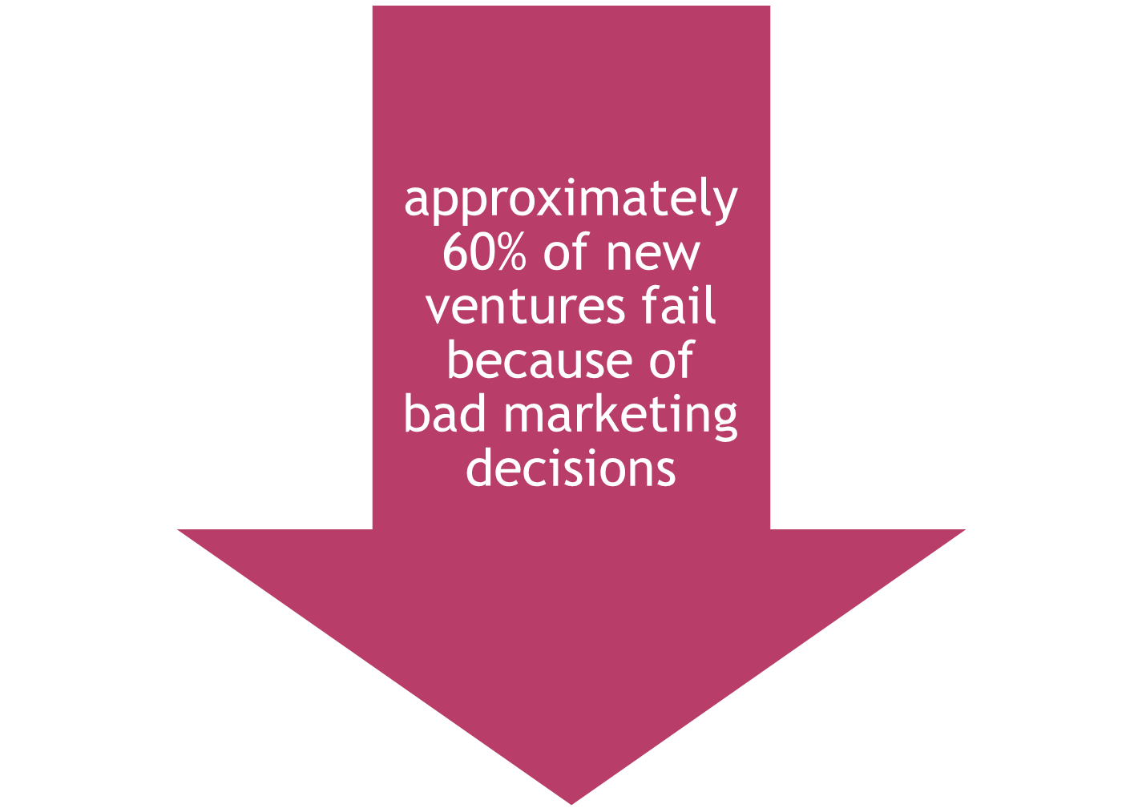

Slide 4

Who will buy the product or service ?
What is the size (no. of customer) of the potential market ?
What price should be charged ?
what is the most appropriate distribution channel ?
What is the most effective promotional strategy to reach and inform potential customers ?
Competitors
Focus Group not expensive technique for research

Slide 5



Slide 6

Newspaper articles- names, interviewed named should be scanned to make your research more authenticated with respect to market issues
Libraries: Published material
Government agencies-census data etc (demographics etc)
Internet

Slide 7
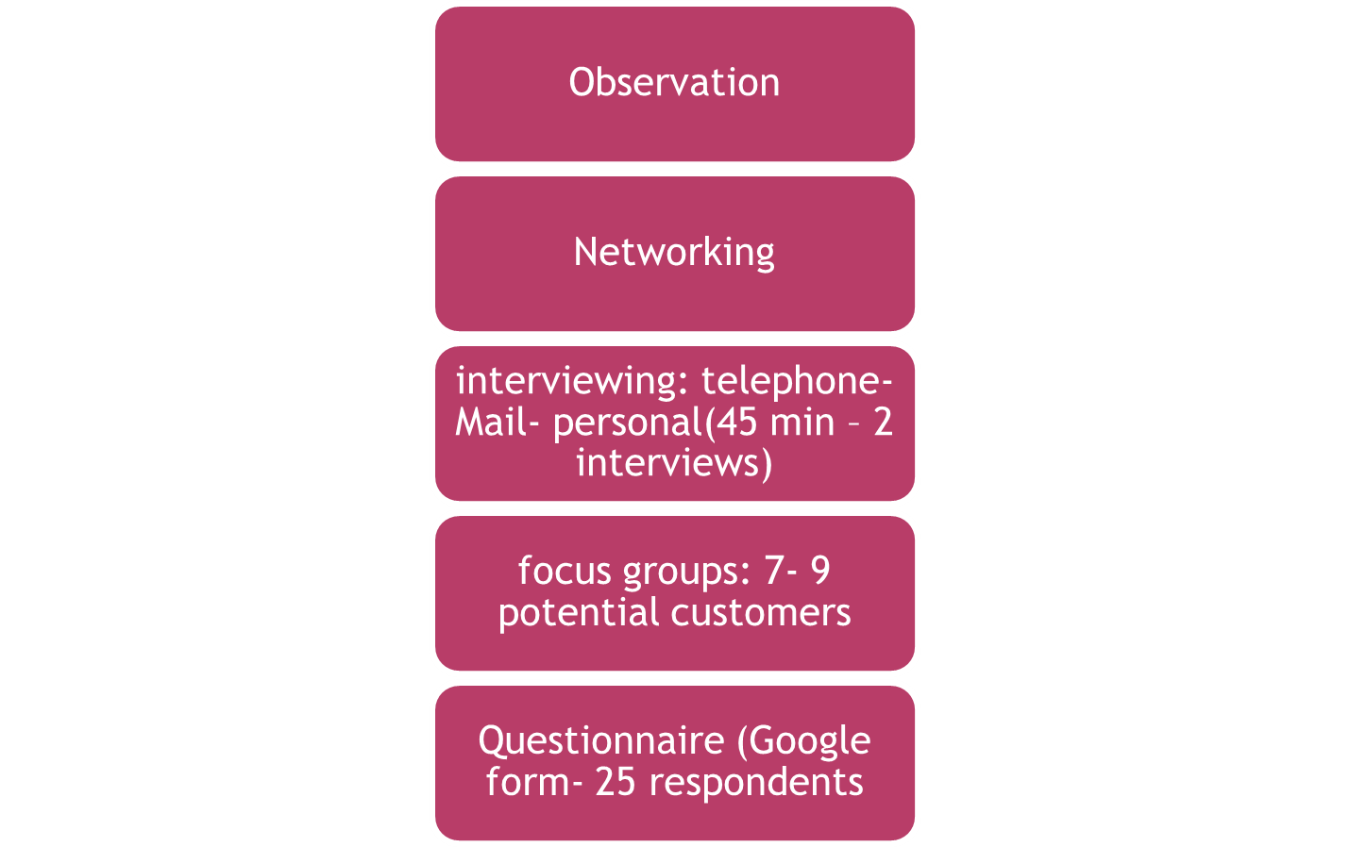

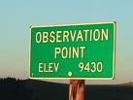

Slide 8



Slide 9
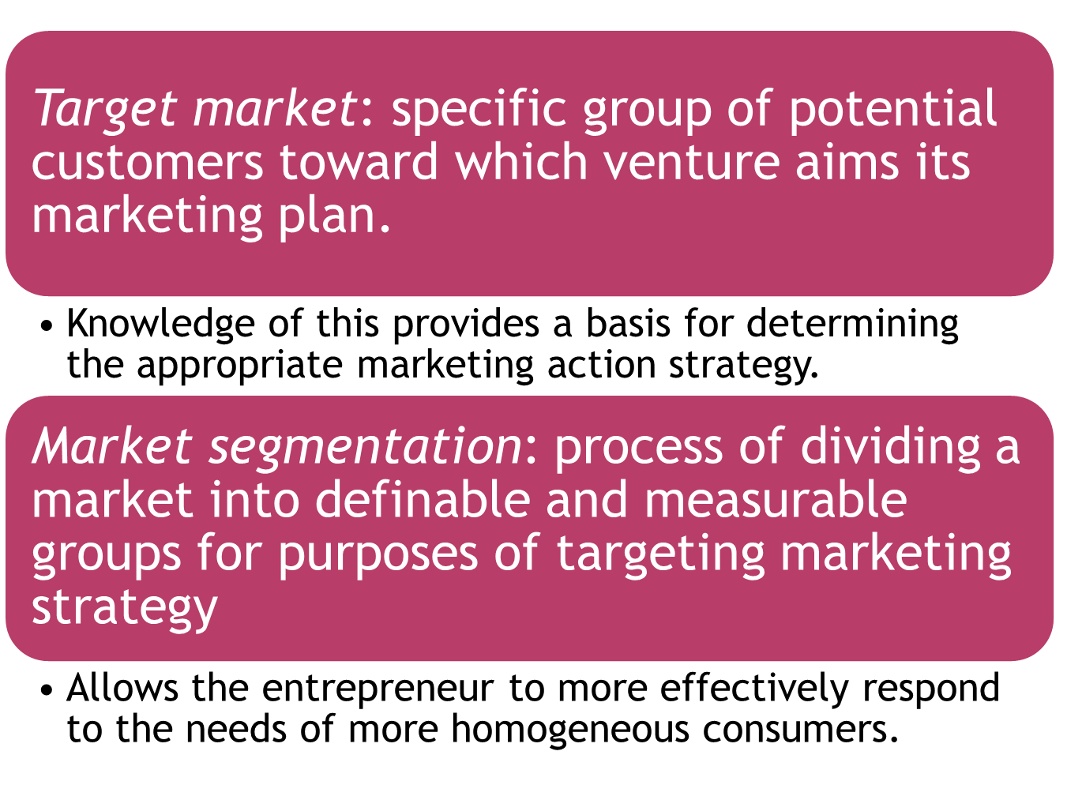

Slide 10
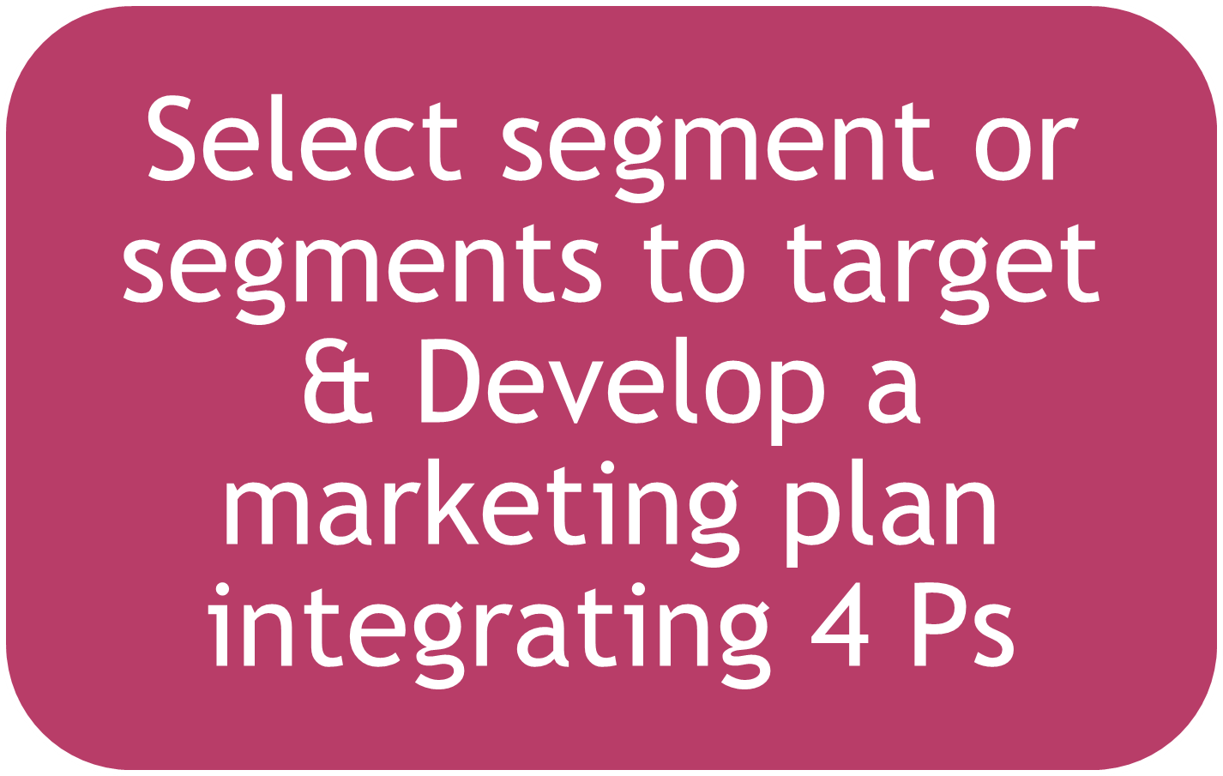

Slide 11


Slide 12
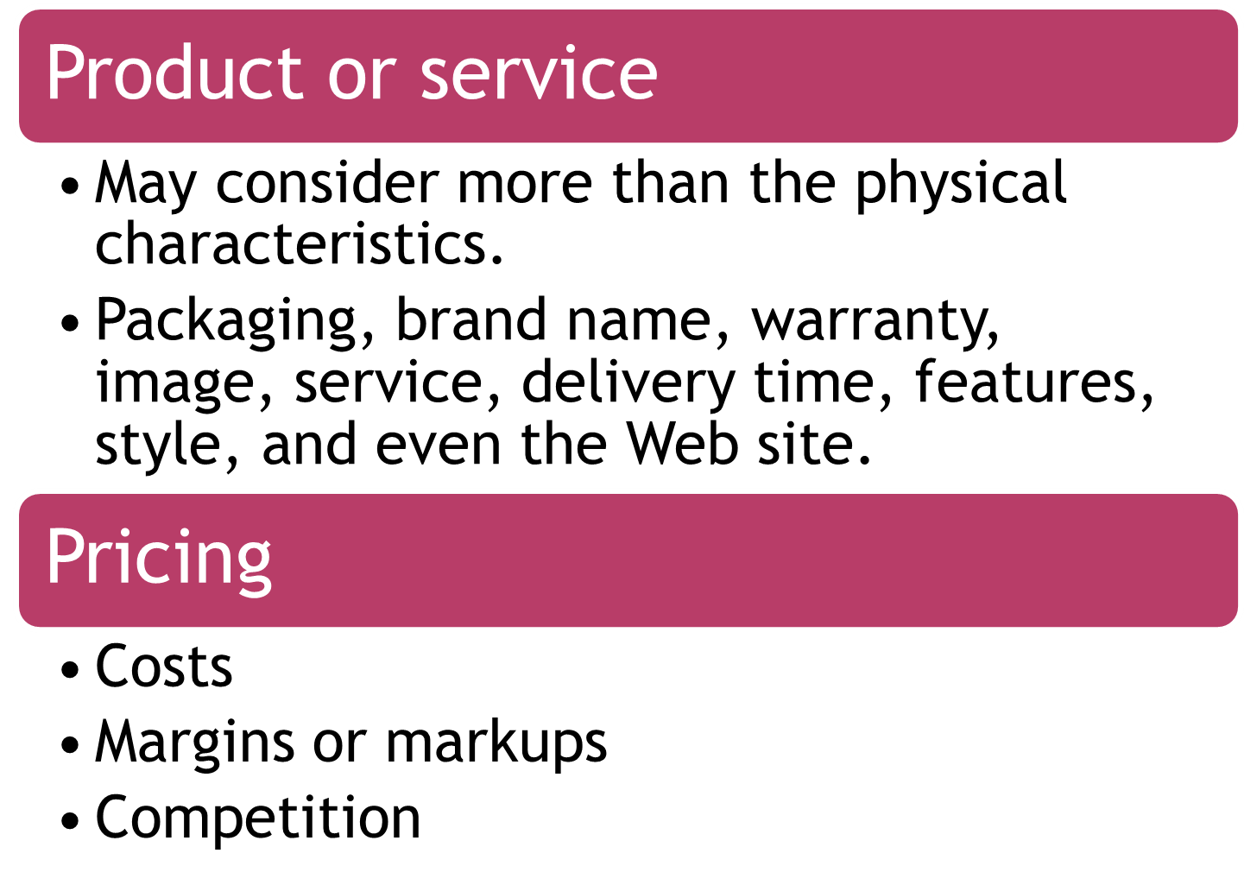

Slide 13
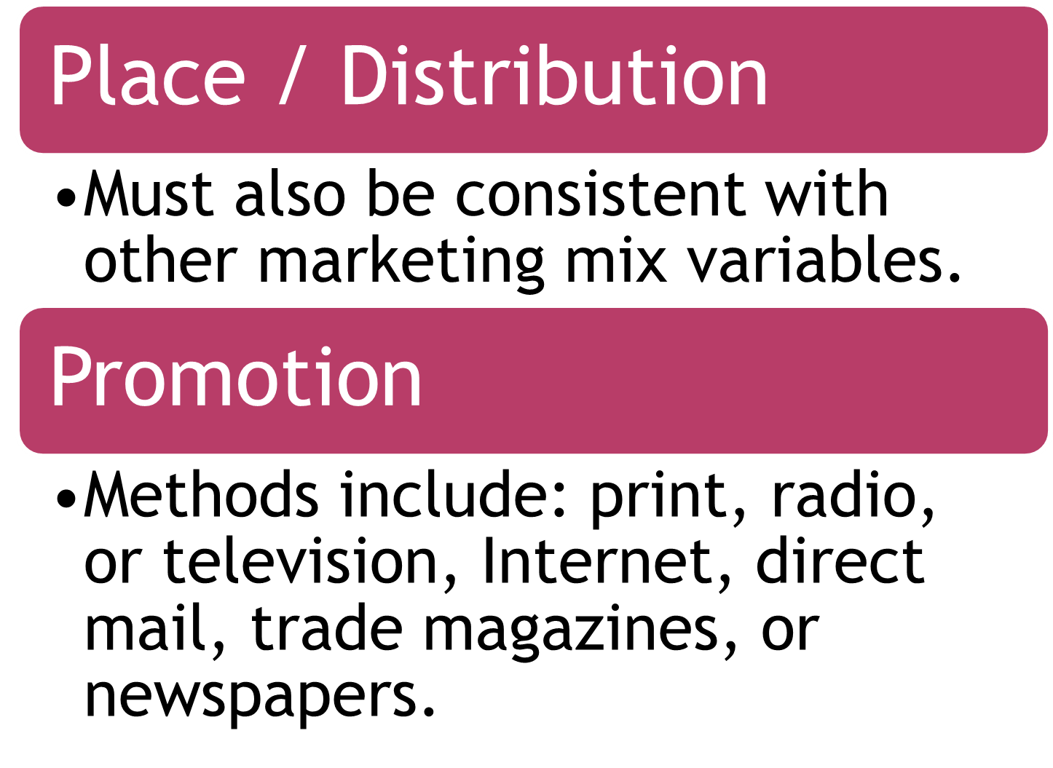

Slide 14

Market research – presentation
  Show me the recording ( 6- 8 FG)
  Google form ( 25 - Result)
  Telephonic Interviews (2 recording)
  Market research analysis – charts – pie charts

